Slide 1
Predicting Restaurant Health Inspection Grades
By: Ipek Sayar

Slide 2
Project Goal
Food safety is an essential public health concern that affects everyone
Consumers looking to make healthier dining choices by identifying safer restaurants.
Restaurant owners who strive to meet health standards
Results take 1-2 weeks to come out + not frequently performed
Classify restaurant GRADE
Grade that the restaurant got on their health inspection

Slide 3
Class
A
B
C
Met the highest health + safety standards
Some violations, no immediate health risks
Multiple serious violations, near closure
68%
15%
17%

Slide 4
Original Dataset
CAMIS | SCORE
DBA | GRADE DATE
BORO | RECORD DATE
BUILDING | INSPECTION TYPE
STREET | Latitude
ZIPCODE | Longitude
PHONE | Community Board
CUISINE DESCRIPTION | Council District
INSPECTION DATE | Census Tract
ACTION | BIN
VIOLATION CODE | BBL
VIOLATION DESCRIPTION | NTA
CRITICAL FLAG | GRADE
NYC Food Establishment Health Inspections 2012-2023
Instances: 103,426
Attributes: 26

Slide 5
Preprocessing
Handling Missing Values:
Class
40% missing.
Used "Score" column (no missing values) to calculate grades per NYC Health guidelines:
0-13 → A
14-27 → B
28+ → C
Filled missing grades using Excel IF-THEN statements.
Removed "Score" column.
Attributes
20% of "Grade Date" values were missing; replaced with placeholder (1/1/2024).

Slide 6
Preprocessing
Removing Irrelevant Columns:
Removed CAMI (restaurant ID) and Phone Number as they are unique to each establishment.
Weka Compatibility:
Removed punctuation using Excel’s Find and Replace.
Used StringToNominal filter in Weka.
Most ML models require nominal or numeric data to function properly.
Sampling for Efficiency:
Used Python for stratified sampling to reduce dataset to 1500 instances.
Maintaining class proportions for accurate representation.

Slide 7
Dataset after Preprocessing
DBA | GRADE DATE
BORO | RECORD DATE
BUILDING | INSPECTION TYPE
STREET | Latitude
ZIPCODE | Longitude
CUISINE DESCRIPTION | Community Board
INSPECTION DATE | Council District
ACTION | Census Tract
VIOLATION CODE | BIN
VIOLATION DESCRIPTION | BBL
CRITICAL FLAG | NTA
Instances: 1,500
Attributes: 23
Class Proportions:
A: 68 %
B: 15 %
C: 17%

Slide 8
Preprocessing 2
The dataset has too many "A" grades, causing classifiers to mostly predict "A" and perform really poorly on minority grades ("B" and "C").
Bad accuracy (60%) , precision (0.4<), and recall (0.5<)
Weka's SMOTE filter generates synthetic instances of minority classes, helping balance the class while still being representative of the population.
Don't overuse so models don't overly depend on synthetic instances instead of the actual ones.
Reduces bias toward the majority class, allowing for better performance and more accurate predictions across all grades.

Slide 9
Dataset after Preprocessing 2
DBA | GRADE DATE
BORO | RECORD DATE
BUILDING | INSPECTION TYPE
STREET | Latitude
ZIPCODE | Longitude
CUISINE DESCRIPTION | Community Board
INSPECTION DATE | Council District
ACTION | Census Tract
VIOLATION CODE | BIN
VIOLATION DESCRIPTION | BBL
CRITICAL FLAG | NTA
Instances: 2118
Attributes: 23
Class Proportions:
A: 48 %
B: 25 %
C: 27%

Slide 10
Intuition
DBA (Chain Name) : Chain health standards vary.
Building: Shared sanitation standards/issues.
Street: Upscale = stricter standards, high-traffic = more wear and tear.
Cuisine: Specialized handling affects violations.
Action Taken: Reflects cleanliness management.
Violation Code: Indicates specific health risks.
Violation Description: Detailed violation reason..
Critical Flag: Severe violations lead to lower grades.
Longitude & Latitude: Location affects inspection outcomes.
Community Board: Varies in regulatory strictness.
Council District: Influences regulations and resources.

Slide 11

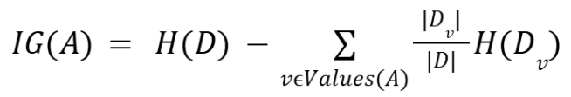
InfoGainAttributeEval
1.2051 | Latitude
1.2051 | Longitude
1.1905 | BBL
1.1861 | DBA
1.1711 | BIN
0.9961 | BUILDING
0.6694 | GRADE DATE
0.5982 | INSPECTION DATE
0.564 | Census Tract
0.5568 | STREET
Measures how much knowing an attribute reduces uncertainty about the target class.
Attributes with an information gain above 0.5 were selected.
Location + Date Attributes

Slide 12
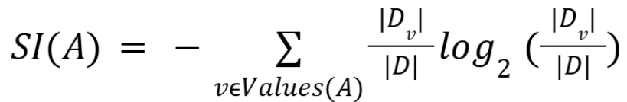
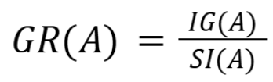
GainRatioAttributeEval
0.28012 | ACTION
0.11639 | DBA
0.11555 | Longitude
0.11555 | Latitude
0.11441 | BBL
0.11273 | BIN
0.10062 | BUILDING
0.08119 | GRADE DATE
0.07668 | INSPECTION DATE
0.06548 | STREET
0.0649 | Census Tract
0.0447 | VIOLATION DESCRIPTION
0.03475 | VIOLATION CODE
0.03022 | NTA
0.02594 | CRITICAL FLAG
Similar to InfoGain but adjusts scores to prevent attributes with many possible values from being favored (Normalization).
Attributes with a gain ratio above 0.25 were selected.
Location + Date + Violation

Slide 13
ClassifierAttributeEval
NTA
ACTION
VIOLATION CODE
CUISINE DESCRIPTION
INSPECTION DATE
ZIPCODE
BBL
BORO
BUILDING
Assesses attribute importance based on how well they improve a specific classifier's predictions.
Default classifier was used: zeroR
The best 17 attributes were selected.
STREET
VIOLATION DESCRIPTION
CRITICAL FLAG
GRADE DATE
Census Tract
BIN
RECORD DATE
Council District
Location
w/o long & lat + Date + Violation

Slide 14
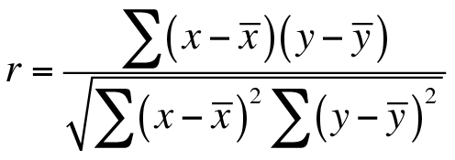
CorrelationAttributeEval
ACTION
INSPECTION TYPE
CRITICAL FLAG
VIOLATION CODE
GRADE DATE
VIOLATION DESCRIPTION
CUISINE DESCRIPTION
ZIPCODE
BORO
Council District
Community Board
DBA
NTA
Evaluates the relationship between each attribute and the target class using correlation coefficients.
Attributes with a correlation of 0.25 or higher were selected.
Location
w/o long & lat + Violation + Governance

Slide 15



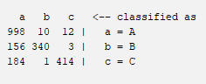

OneR
Simple algorithm that creates classification rules based on a single attribute, selecting the one with the lowest error rate for surprisingly accurate results.
InfoGain
A lot of False As
Correlation
Intuition
GainRatio
Classifier
Notes:
Not much of a difference between the different attribute selection algorithms

Slide 16



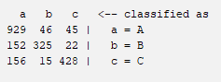

Random Tree
Builds multiple decision trees using random subsets of attributes, reducing overfitting and improving generalization to new data.
InfoGain
A lot of False As
Correlation
Intuition
GainRatio
Classifier

Slide 17



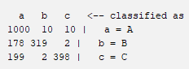

Decision Table
Tabular representation that combines attribute values with class labels, simplifying classification by focusing on the most relevant features.
InfoGain
A lot of False As
Correlation
Intuition
GainRatio
Classifier

Slide 18


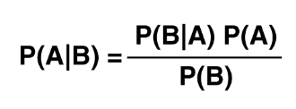

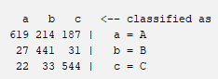

NaiveBayes
Probabilistic classifier based on Bayes’ Theorem. Assumes that each attribute is independent of the others.
InfoGain
Lot of As classified wrong
Correlation
Intuition
GainRatio
Classifier
Notes:
When the features of a rare class are distinct, Naive Bayes easily assigns them a unique probability profile, making it easier to identify instances of that class. However, in the abundant class, these features become more generic, increasing the likelihood of misclassification.

Slide 19
Analysis
Accuracy Trends
OneR: 82% - 84.5%, highest at 84.47% (GainRatio).
Random Tree & Decision Table: Low 80% range.
NaiveBayes: Low 70s Range, lowest at 67.47% (InfoGain).
Precision and Recall
OneR: Precision 0.875, Recall 0.845.
Random Tree: Slightly lower than OneR in metrics.
NaiveBayes: Underperforms in Recall, misses more positive instances. (0.675 under InfoGain)
False Positive Rate
NaiveBayes: Low FP rate (0.089 under GainRatio).
OneR: Slightly higher FP rate (0.123) but still effective.
ROC Area
NaiveBayes: Highest ROC Area (0.964 under GainRatio), excels at distinguishing classes.
Everything else as mid range ROC Area, showing decent class separation.

Slide 20
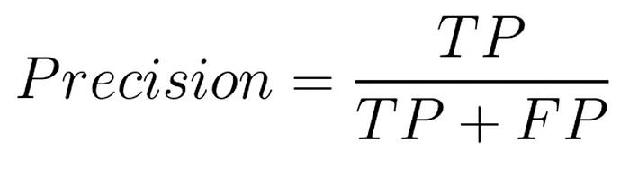
Results
Top 10 overall best performing:
GainRatio OneR
Intuition OneR
InfoGain OneR
GainRatio RandomTree
Classifier OneR
Correlation OneR
Intuition RandomTable
InfoGain RandomTree
GainRatio DecisionTable
Intuition DecisionTable
Want to minimize False Positives so rating is decided based on greater Precision.
It's better for a healthy restaurant to be misclassified as unhealthy than for an unhealthy restaurant to be misclassified as healthy.

Slide 21
Best Classification Model
GainRatio OneR provides the best combination of critical metrics for predicting health inspection grades.
Leads in accuracy at 84.47%.
Achieves a the highest precision of 0.875 and recall of 0.845, balancing correctness and comprehensiveness.
Maintains a false positive rate of 0.123, minimizing misclassifications.
Its overall metrics make it a reliable choice.

Slide 22
Future
I still noticed that there were quite a lot of False As which tells me that the classifier is still being affected by the abundance of the A class value.
I want to perhaps use more of Weka’s SMOTE filter to further better the class proportions
Experiment with oversampling to get a dataset with better class proportions from the original population without creating synthetic values

